Slide 1
XII
(DuoDecim)
Game by: Michael Medulla, Kaeden Bryer, Pablo Avila, Spencer Roeren

Slide 2
Application
Games have been around for an extremely long time and can help people destress and relax. Today's world is full of stress and anxiety and we are trying to remove even just a little bit of that.

Slide 3
What does it do?

Slide 4
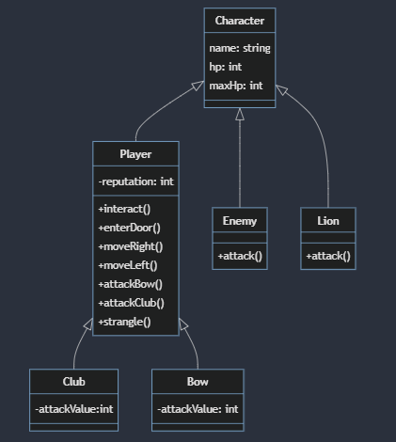
UML Diagram

Slide 5
What did we Learn?
We learned how to use Swing and AWL to create a 2D turn based combat RPG.
We learned how to display multiple images, take key input and assign it to and action.

Slide 6
DEMONSTRATION

